Slide 1
Lösung des n-Damenproblems auf einem adiabatischen Quantencomputer
Jugend Forscht Projekt von Jakov D. Wallbrecher, Jonathan Treffler & Paul Schappert

Slide 2
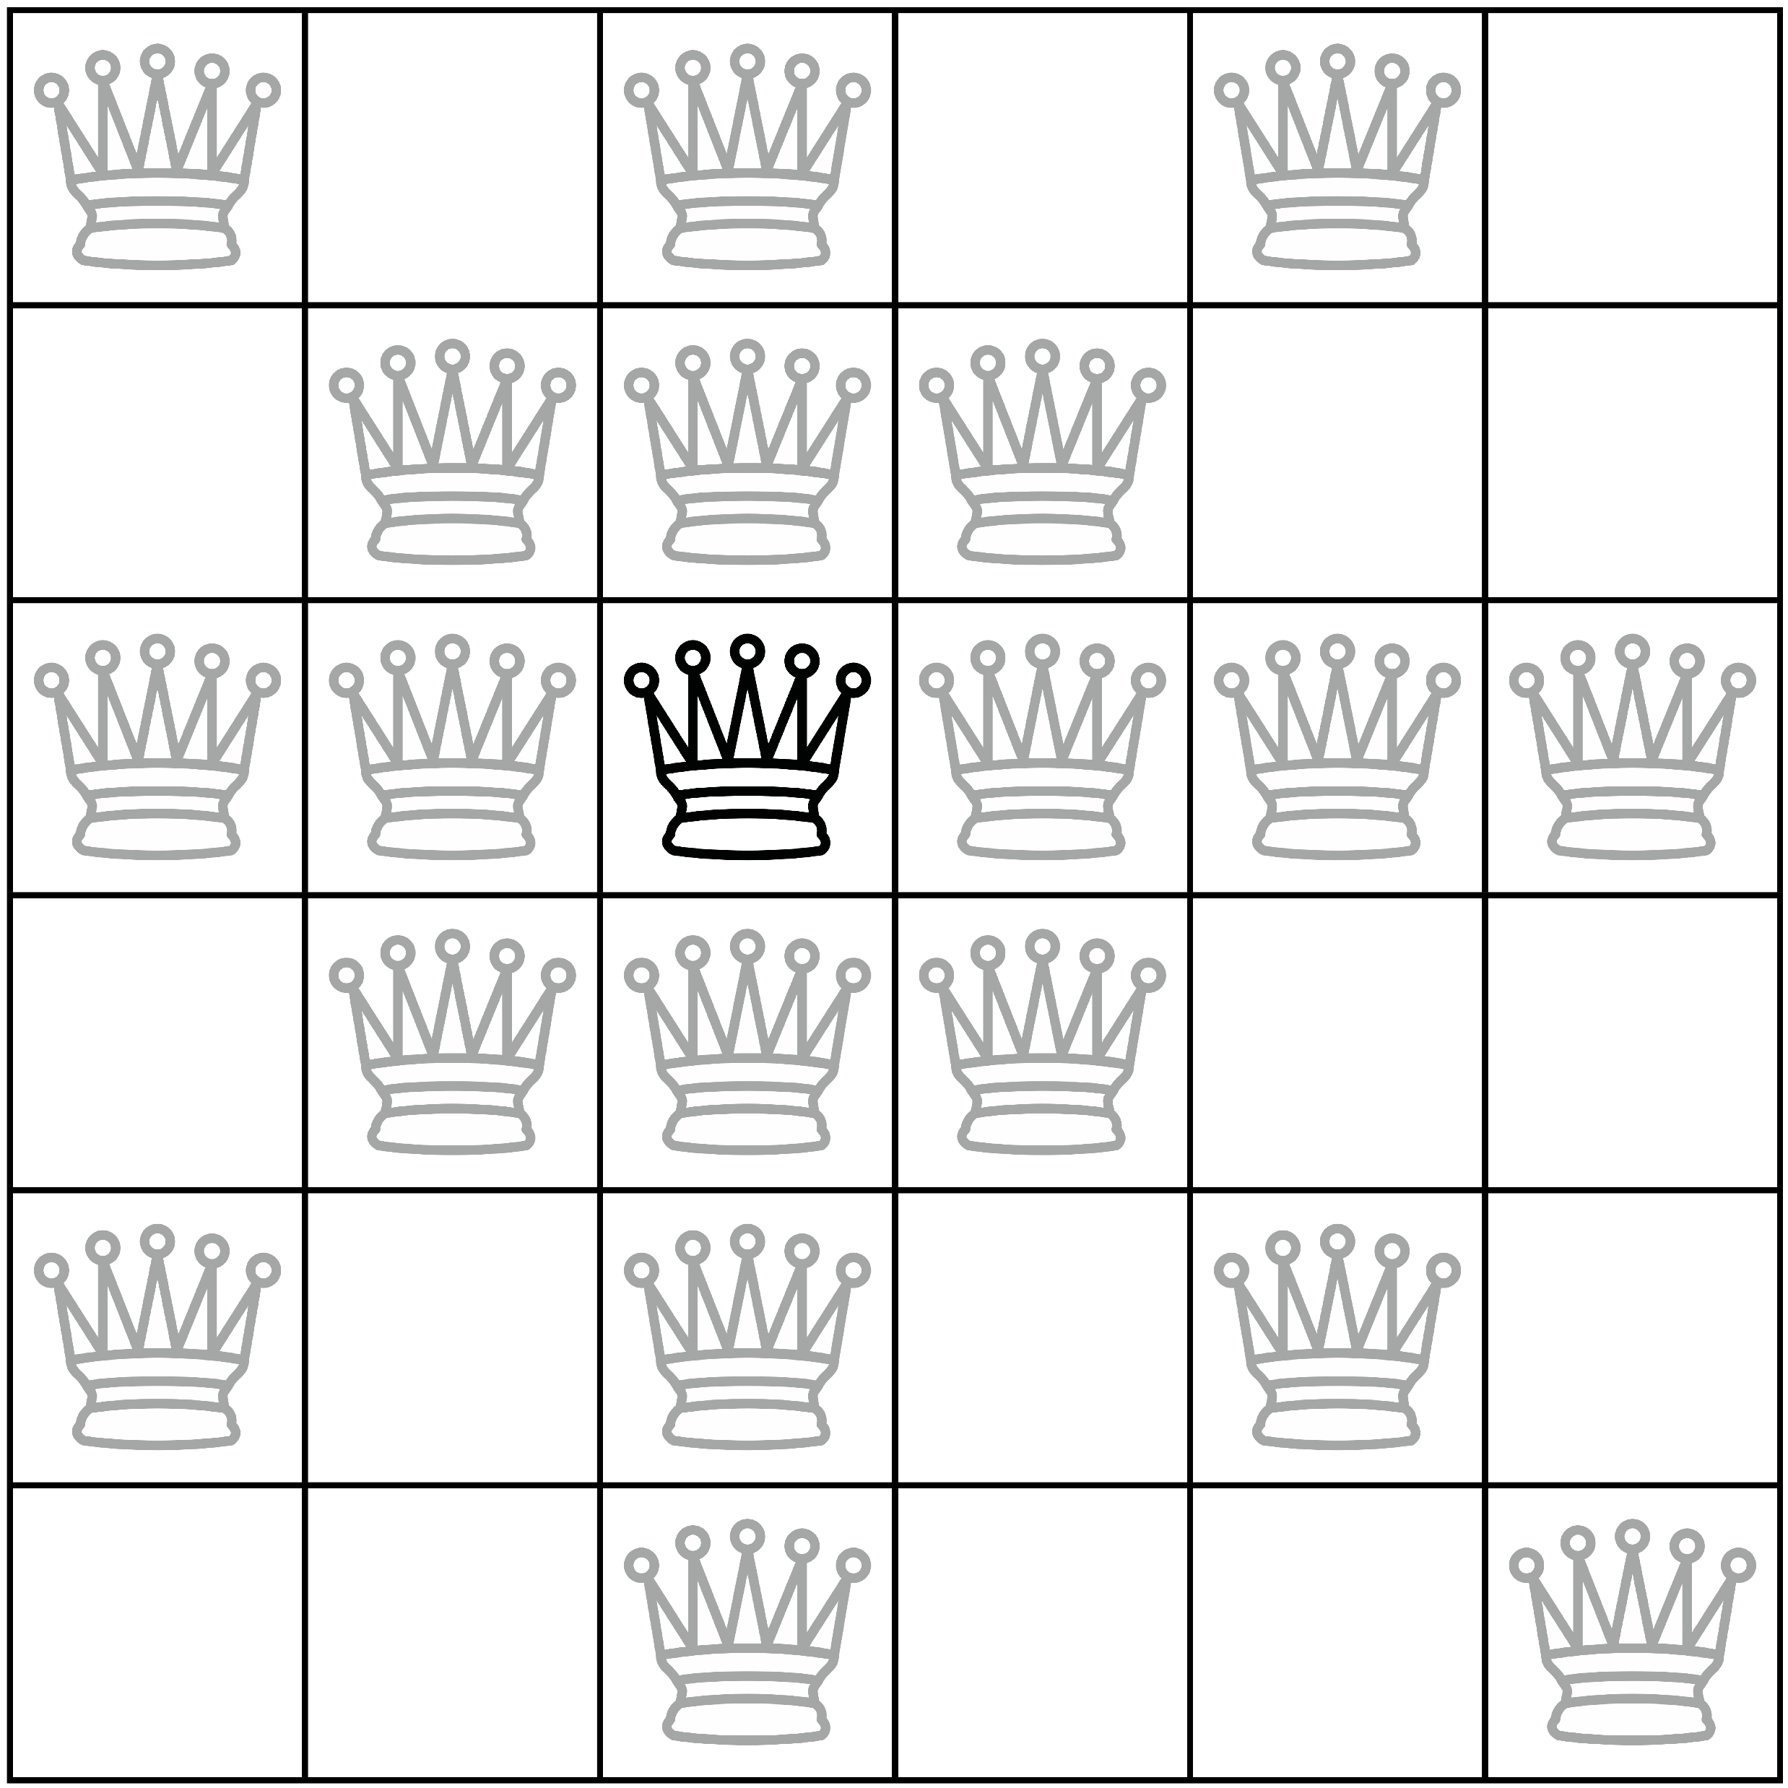

Das n-Damenproblem
pro Spalte höchstens eine Dame
pro Reihe höchstens eine Dame
pro Diagonale höchstens eine Dame

Slide 3
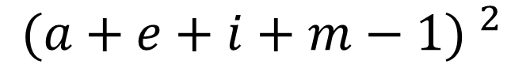
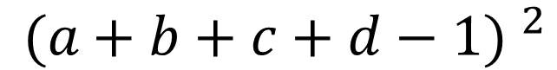
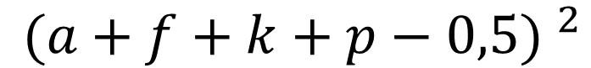
a | b | c | d
e | f | g | h
i | j | k | l
m | n | o | p
$${ (a+b+c+d−1) }^{2}$$
$${ (a+f+k+p−0,5) }^{2}$$
$${ (a+e+i+m−1) }^{2}$$

Slide 4
$${(a+b+c+d−1)}^{2}+{(e+f+g+h−1)}^{2}+{(i+j+k+l−1)}^{2}+{(m+n+o+p−1)}^{2}+$$
$${(a+e+i+m−1)}^{2}+{(b+f+j+n−1)}^{2}+{(c+g+k+o−1)}^{2}+{(d+h+l+p−1)}^{2}+$$
$${(i+n−0,5)}^{2}+{(e+j+o−0,5)}^{2}+{(a+f+k+p−0,5)}^{2}+{(b+g+l−0,5)}^{2}+{\left(c+h−0,5\right)}^{2}+$$
$${(b+e−0,5)}^{2}+{(c+f+i−0,5)}^{2}+{(d+g+j+m−0,5)}^{2}+{(h+k+n−0,5)}^{2}+{\left(l+o−0,5\right)}^{2}$$
 | a | b | c | d | e | f | g | h | i | j | k | l | m | n | o | p
a | -2 | 2 | 2 | 2 | 2 | 2 | 0 | 0 | 2 | 0 | 2 | 0 | 2 | 0 | 0 | 2
b | 0 | -2 | 2 | 2 | 2 | 2 | 2 | 0 | 0 | 2 | 0 | 2 | 0 | 2 | 0 | 0
c | 0 | 0 | -2 | 2 | 0 | 2 | 2 | 2 | 2 | 0 | 2 | 0 | 0 | 0 | 2 | 0
d | 0 | 0 | 0 | -2 | 0 | 0 | 2 | 2 | 0 | 2 | 0 | 2 | 2 | 0 | 0 | 2
e | 0 | 0 | 0 | 0 | -2 | 2 | 2 | 2 | 2 | 2 | 0 | 0 | 2 | 0 | 2 | 0
f | 0 | 0 | 0 | 0 | 0 | -2 | 2 | 2 | 2 | 2 | 2 | 0 | 0 | 2 | 0 | 2
g | 0 | 0 | 0 | 0 | 0 | 0 | -2 | 2 | 0 | 2 | 2 | 2 | 2 | 0 | 2 | 0
h | 0 | 0 | 0 | 0 | 0 | 0 | 0 | -2 | 0 | 0 | 2 | 2 | 0 | 2 | 0 | 2
i | 0 | 0 | 0 | 0 | 0 | 0 | 0 | 0 | -2 | 2 | 2 | 2 | 2 | 2 | 0 | 0
j | 0 | 0 | 0 | 0 | 0 | 0 | 0 | 0 | 0 | -2 | 2 | 2 | 2 | 2 | 2 | 0
k | 0 | 0 | 0 | 0 | 0 | 0 | 0 | 0 | 0 | 0 | -2 | 2 | 0 | 2 | 2 | 2
l | 0 | 0 | 0 | 0 | 0 | 0 | 0 | 0 | 0 | 0 | 0 | -2 | 0 | 0 | 2 | 2
m | 0 | 0 | 0 | 0 | 0 | 0 | 0 | 0 | 0 | 0 | 0 | 0 | -2 | 2 | 2 | 2
n | 0 | 0 | 0 | 0 | 0 | 0 | 0 | 0 | 0 | 0 | 0 | 0 | 0 | -2 | 2 | 2
o | 0 | 0 | 0 | 0 | 0 | 0 | 0 | 0 | 0 | 0 | 0 | 0 | 0 | 0 | -2 | 2
p | 0 | 0 | 0 | 0 | 0 | 0 | 0 | 0 | 0 | 0 | 0 | 0 | 0 | 0 | 0 | -2
2 a k

Slide 5
-2 | 2 | 2 | 2 | 2 | 2 | 0 | 0 | 2 | 0 | 2 | 0 | 2 | 0 | 0 | 2
0 | -2 | 2 | 2 | 2 | 2 | 2 | 0 | 0 | 2 | 0 | 2 | 0 | 2 | 0 | 0
0 | 0 | -2 | 2 | 0 | 2 | 2 | 2 | 2 | 0 | 2 | 0 | 0 | 0 | 2 | 0
0 | 0 | 0 | -2 | 0 | 0 | 2 | 2 | 0 | 2 | 0 | 2 | 2 | 0 | 0 | 2
0 | 0 | 0 | 0 | -2 | 2 | 2 | 2 | 2 | 2 | 0 | 0 | 2 | 0 | 2 | 0
0 | 0 | 0 | 0 | 0 | -2 | 2 | 2 | 2 | 2 | 2 | 0 | 0 | 2 | 0 | 2
0 | 0 | 0 | 0 | 0 | 0 | -2 | 2 | 0 | 2 | 2 | 2 | 2 | 0 | 2 | 0
0 | 0 | 0 | 0 | 0 | 0 | 0 | -2 | 0 | 0 | 2 | 2 | 0 | 2 | 0 | 2
0 | 0 | 0 | 0 | 0 | 0 | 0 | 0 | -2 | 2 | 2 | 2 | 2 | 2 | 0 | 0
0 | 0 | 0 | 0 | 0 | 0 | 0 | 0 | 0 | -2 | 2 | 2 | 2 | 2 | 2 | 0
0 | 0 | 0 | 0 | 0 | 0 | 0 | 0 | 0 | 0 | -2 | 2 | 0 | 2 | 2 | 2
0 | 0 | 0 | 0 | 0 | 0 | 0 | 0 | 0 | 0 | 0 | -2 | 0 | 0 | 2 | 2
0 | 0 | 0 | 0 | 0 | 0 | 0 | 0 | 0 | 0 | 0 | 0 | -2 | 2 | 2 | 2
0 | 0 | 0 | 0 | 0 | 0 | 0 | 0 | 0 | 0 | 0 | 0 | 0 | -2 | 2 | 2
0 | 0 | 0 | 0 | 0 | 0 | 0 | 0 | 0 | 0 | 0 | 0 | 0 | 0 | -2 | 2
0 | 0 | 0 | 0 | 0 | 0 | 0 | 0 | 0 | 0 | 0 | 0 | 0 | 0 | 0 | -2
Notes:
Hamiltonian
Kostenberechnung

Slide 6
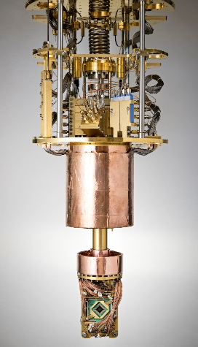
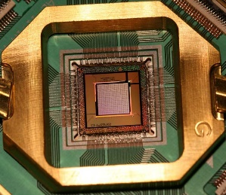
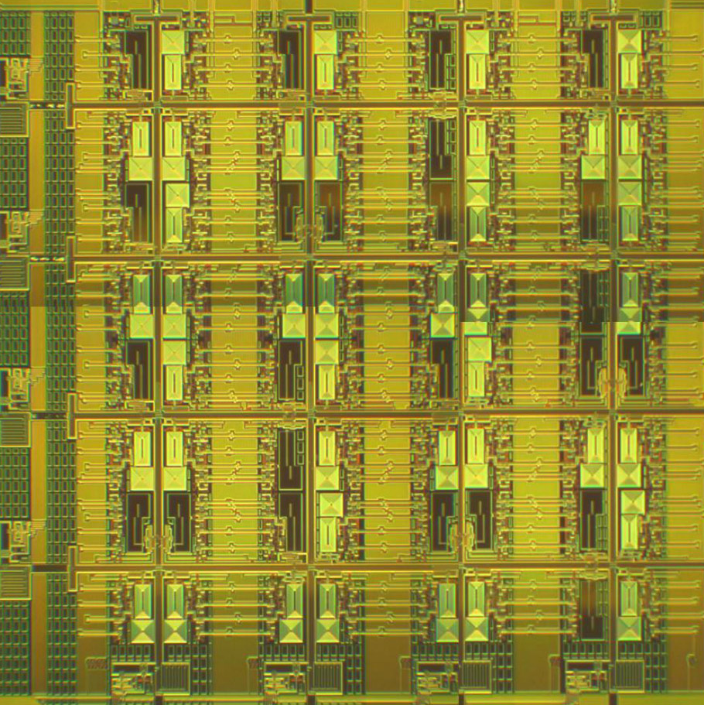
Funktionsweise eines adiabatischen Quantencomputers
0
1
0
1
0
0
1
1
Gleichheit
Messung
1
1
0
0
Notes:
Koppler haben eine Stärke

Slide 7
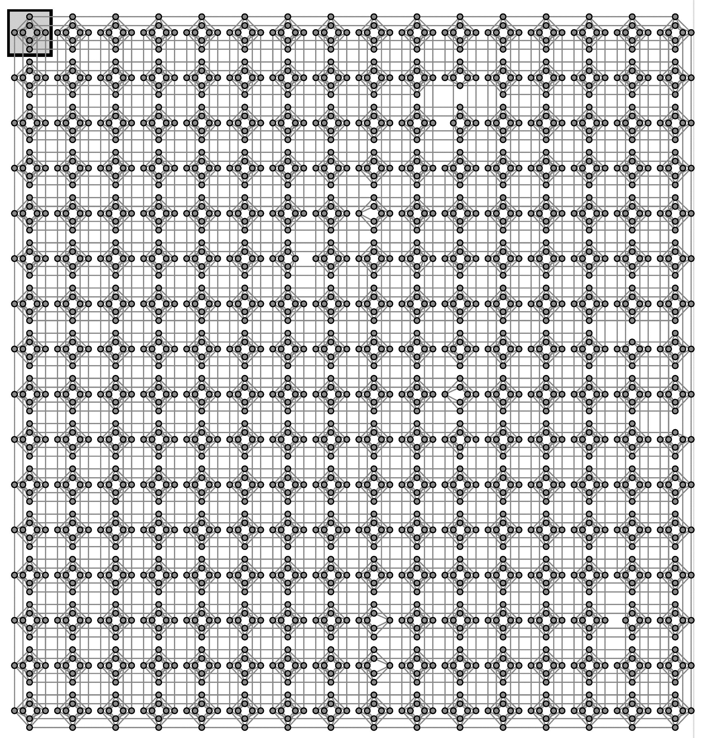
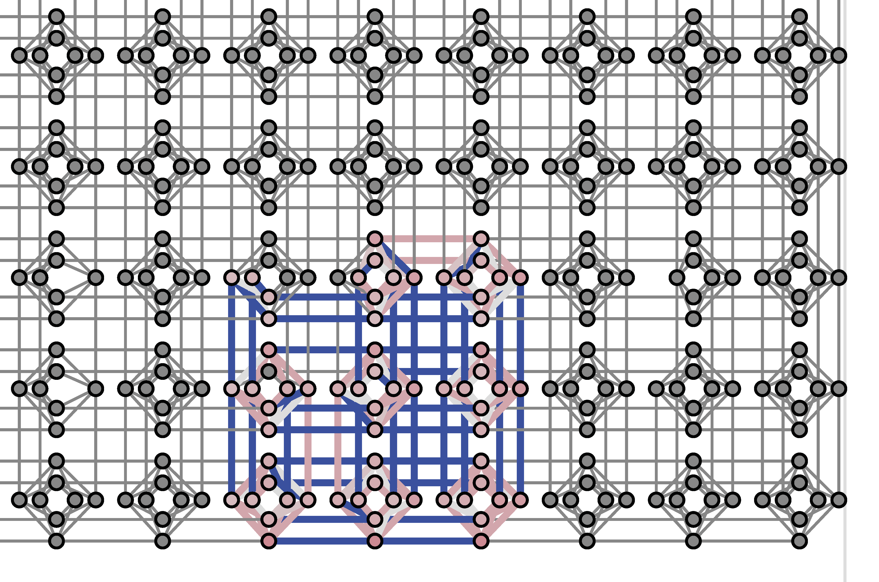
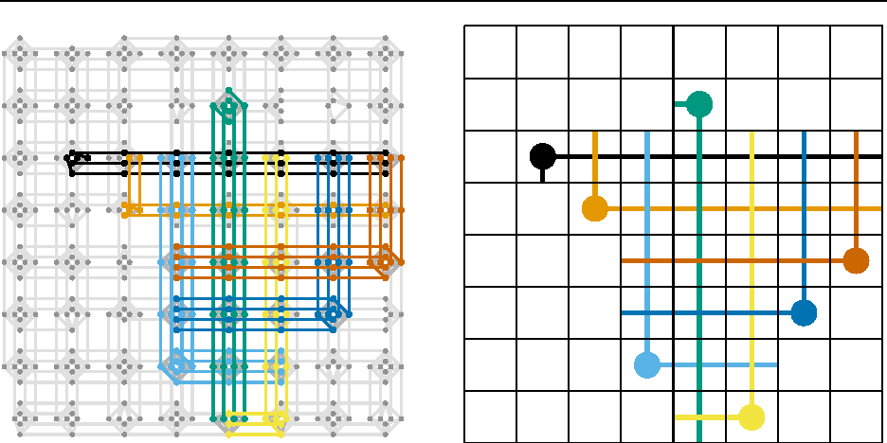
Qubit
Koppler
Notes:
Embedding: basiert auf Hamiltonian
Echte und logische Qubits

Slide 8
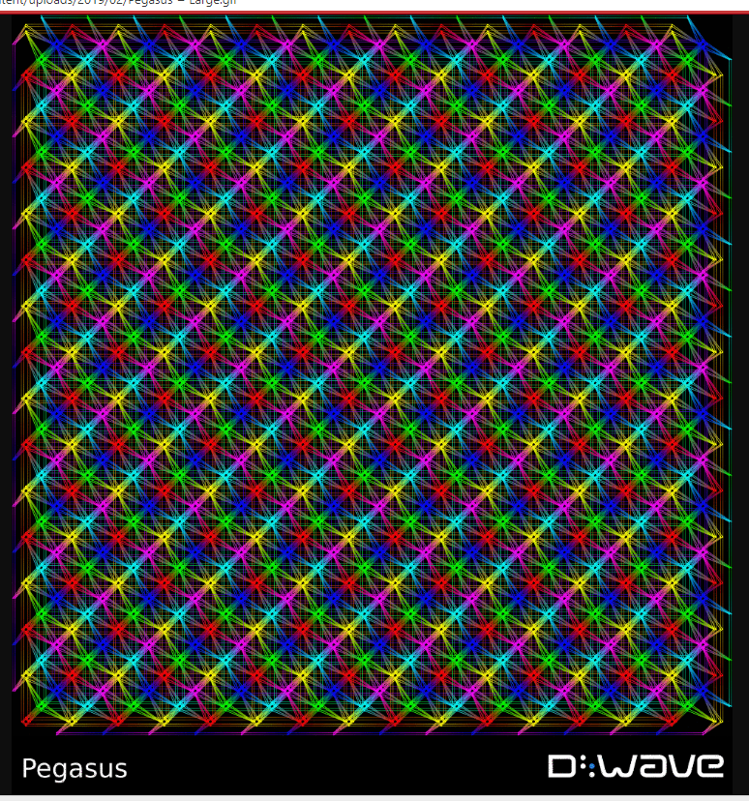
Notes:
Anneal: Initial + eigener

Slide 9
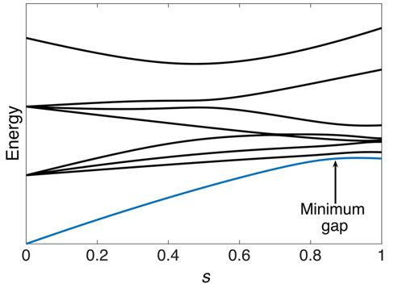
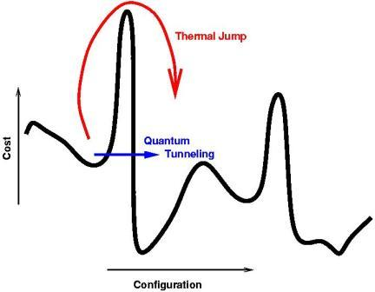
Kosten
Energieärmster Zustand
Energiesprung
Zeit
Kosten
tunneling
Situation
Notes:
-Erst Anneal ablauf
-Immer Energie ärmster Zustand
-Tunneling

Slide 10
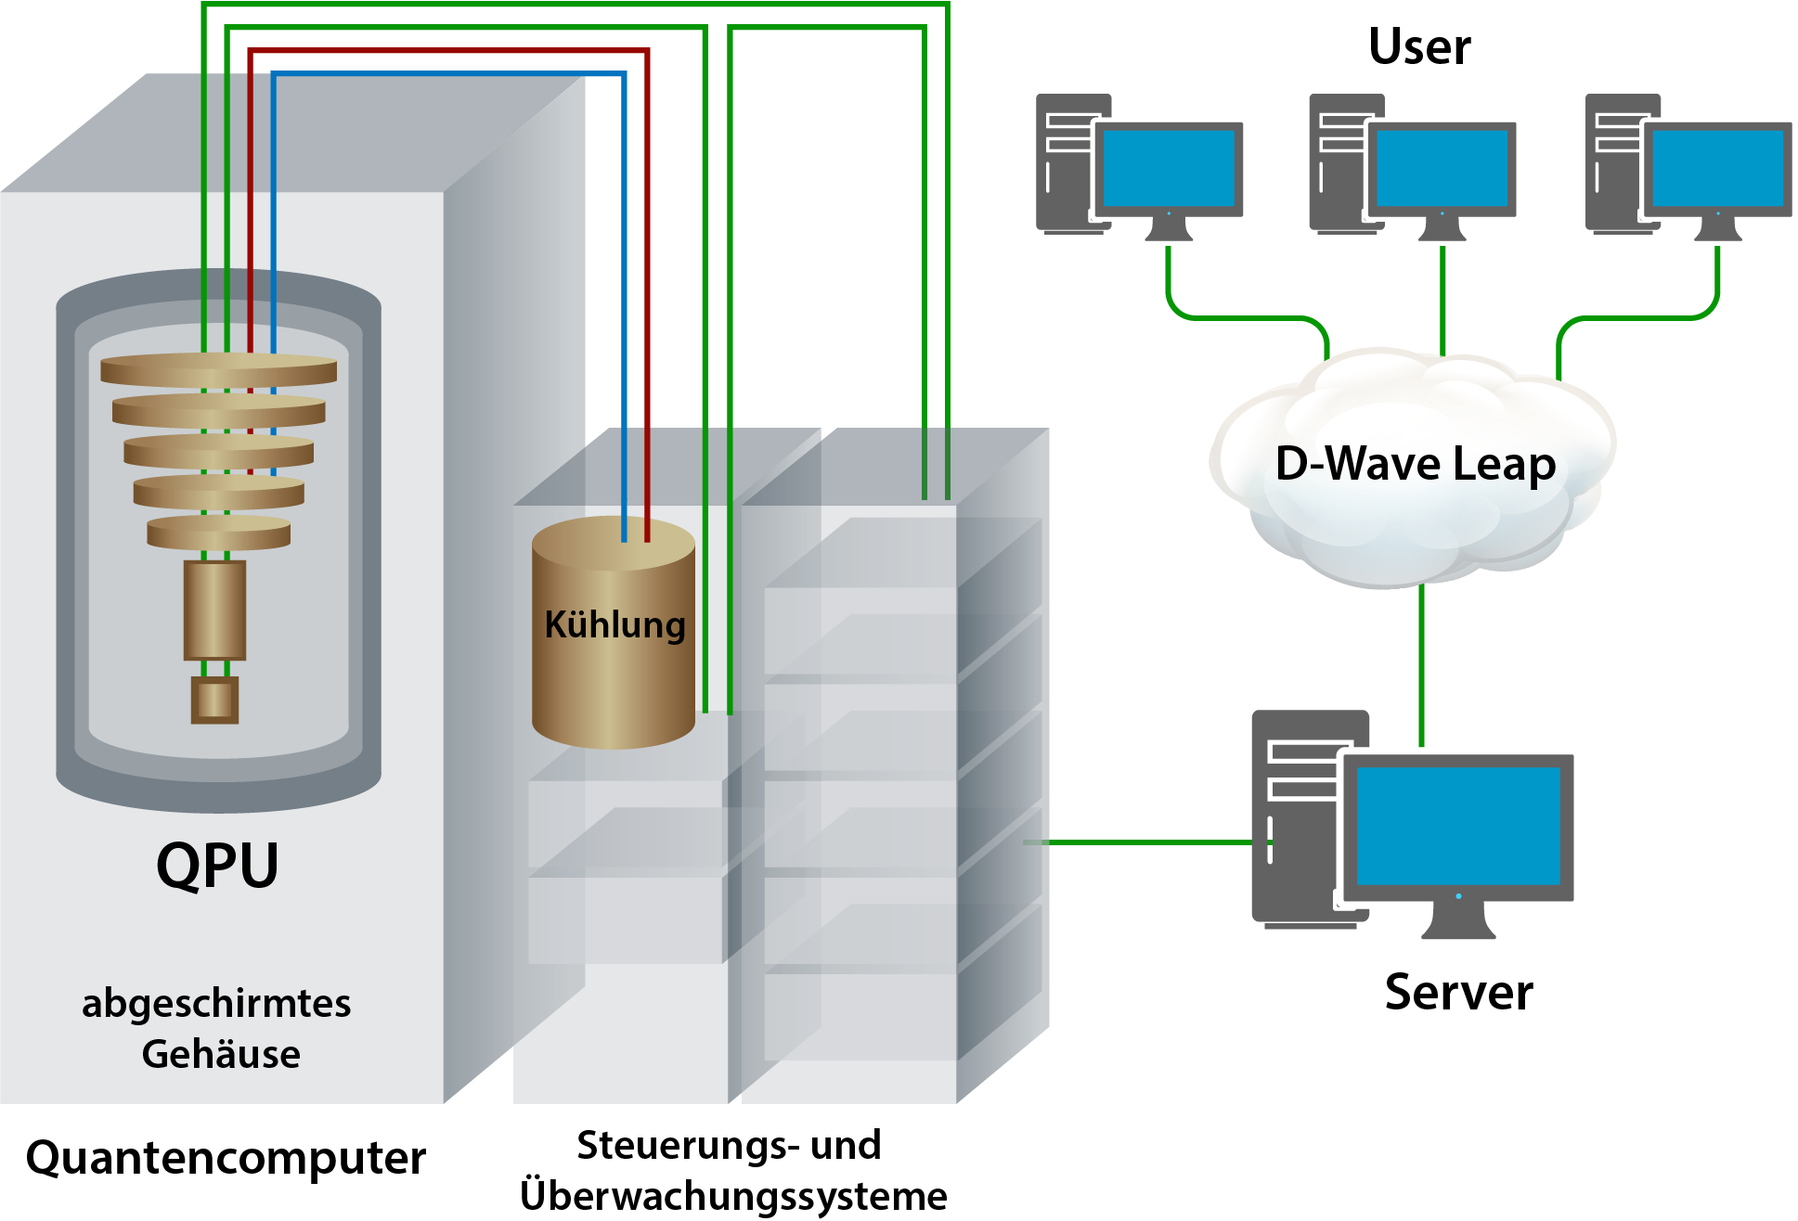
-8.000000 171 [0 0 1 0 1 0 0 0 0 0 0 1 0 1 0 0]
-8.000000 6794 [0 1 0 0 0 0 0 1 1 0 0 0 0 0 1 0]
-6.000000 2 [1 0 0 0 1 0 0 0 0 0 0 1 0 1 0 0]
-6.000000 115 [0 0 0 1 0 0 0 0 1 0 0 0 0 0 1 0]
-6.000000 7 [0 0 1 0 0 0 0 0 0 0 0 1 0 1 0 0]
-6.000000 10 [1 0 0 0 0 0 0 1 0 1 0 0 0 0 0 0]
-6.000000 6 [1 0 1 0 0 0 0 0 0 0 0 1 0 1 0 0]
-6.000000 12 [1 0 0 0 0 0 0 1 0 1 0 0 0 0 1 0]
-6.000000 128 [0 1 0 0 0 0 0 1 0 0 0 0 0 0 1 0]
-6.000000 12 [0 0 1 0 1 0 0 0 0 0 0 1 0 0 0 0]
-6.000000 26 [0 0 0 1 1 0 0 0 0 0 0 1 0 1 0 0]
-6.000000 1 [0 0 1 0 1 0 0 0 0 0 0 0 0 1 0 0]
-6.000000 16 [0 0 0 1 1 0 0 0 0 0 0 0 0 1 0 0]
-6.000000 154 [0 0 0 1 0 1 0 0 0 0 0 0 0 0 1 0]
-6.000000 12 [1 0 0 0 0 0 0 0 0 0 0 1 0 1 0 0]
-6.000000 51 [1 1 0 0 0 0 0 1 0 0 0 0 0 0 1 0]
-6.000000 11 [0 0 0 0 1 0 0 0 0 0 0 1 0 1 0 0]
-6.000000 25 [1 0 0 0 0 0 1 0 0 0 0 1 0 1 0 0]
-6.000000 87 [0 0 0 1 0 1 0 0 1 0 0 0 0 0 1 0]
-6.000000 34 [1 0 0 0 0 0 0 1 0 0 0 0 0 0 1 0]
-6.000000 1 [0 0 1 1 1 0 0 0 0 0 0 0 0 1 0 0]
-6.000000 3 [0 0 1 1 1 0 0 0 0 0 0 1 0 1 0 0]
-6.000000 56 [1 0 0 0 0 0 1 0 0 0 0 0 0 1 0 0]
-6.000000 101 [0 0 0 1 0 0 0 1 1 0 0 0 0 0 1 0]
-6.000000 4 [1 0 1 0 1 0 0 0 0 0 0 1 0 1 0 0]
-6.000000 131 [0 1 0 0 0 0 0 1 0 0 0 0 1 0 1 0]
-6.000000 53 [0 0 1 0 0 0 0 0 0 0 0 1 1 0 0 0]
-6.000000 87 [0 1 0 1 0 0 0 0 1 0 0 0 0 0 1 0]
-6.000000 44 [1 1 0 0 0 0 0 1 1 0 0 0 0 0 1 0]
-6.000000 90 [0 1 0 0 0 0 0 0 1 0 0 0 0 0 1 0]
-6.000000 31 [0 0 0 0 0 0 0 1 1 0 0 0 0 0 1 0]
-6.000000 28 [0 0 1 0 1 0 0 0 0 0 0 1 1 0 0 0]
-6.000000 30 [0 0 0 0 0 1 0 0 0 0 0 1 1 0 0 0]

Slide 11
-2 2 2 2 2 2 0 0 2 0 2 0 2 0 0 2
0 -2 2 2 2 2 2 0 0 2 0 2 0 2 0 0
0 0 -2 2 0 2 2 2 2 0 2 0 0 0 2 0
0 0 0 -2 0 0 2 2 0 2 0 2 2 0 0 2
0 0 0 0 -2 2 2 2 2 2 0 0 2 0 2 0
0 0 0 0 0 -2 2 2 2 2 2 0 0 2 0 2
0 0 0 0 0 0 -2 2 0 2 2 2 2 0 2 0
0 0 0 0 0 0 0 -2 0 0 2 2 0 2 0 2
0 0 0 0 0 0 0 0 -2 2 2 2 2 2 0 0
0 0 0 0 0 0 0 0 0 -2 2 2 2 2 2 0
0 0 0 0 0 0 0 0 0 0 -2 2 0 2 2 2
0 0 0 0 0 0 0 0 0 0 0 -2 0 0 2 2
0 0 0 0 0 0 0 0 0 0 0 0 -2 2 2 2
0 0 0 0 0 0 0 0 0 0 0 0 0 -2 2 2
0 0 0 0 0 0 0 0 0 0 0 0 0 0 -2 2
0 0 0 0 0 0 0 0 0 0 0 0 0 0 0 -2

Slide 12
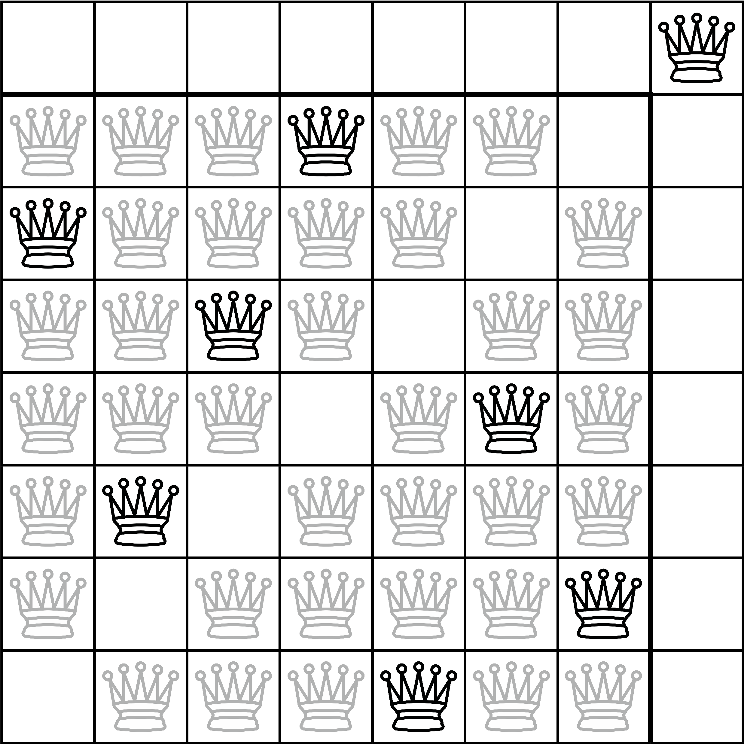

Slide 13
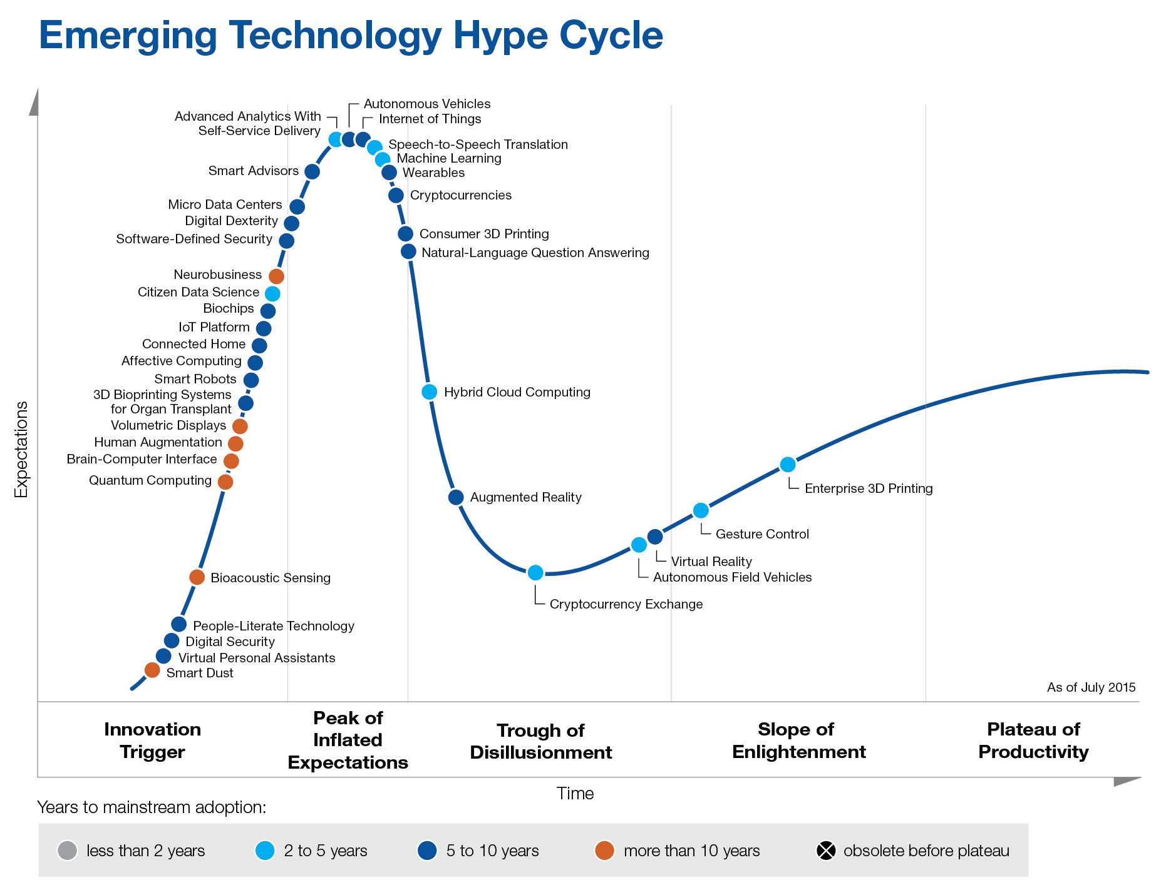

Slide 14
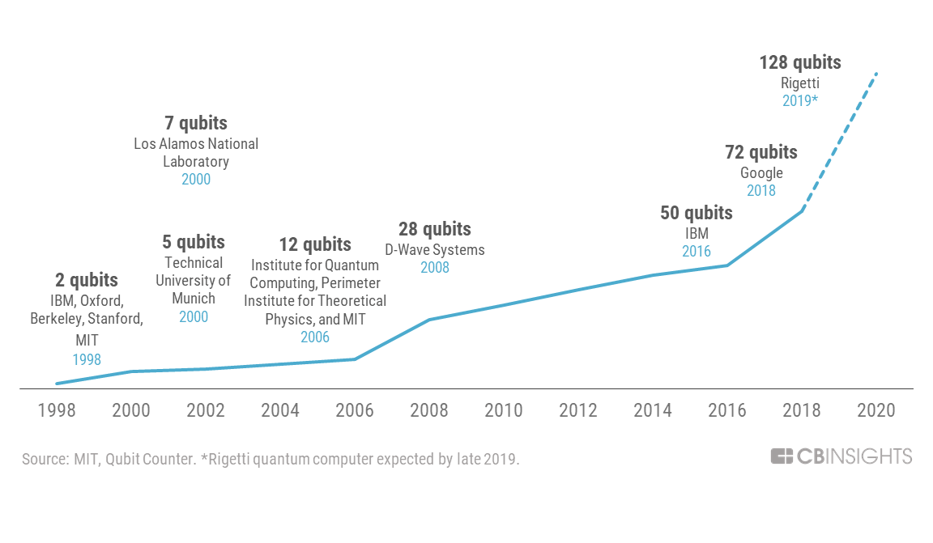

Slide 15
